Slide 1
NetApp FAS3250 cDOT Log Backup Architecture
Mike Arndt, Systems Engineer
2013-10-17

Slide 2
Log Backup Solution
Log Backup Standard Architecture:
FAS3250 HA Pair
Two node switchless cluster
6 DS4246 shelves of 2TB SATA drives
10GbE connectivity for data access
1GbE connectivity for management
Software licenses:
NFS and CIFS

Slide 3
Requirements / Limitations in cDOT 8.2.1
1000 volumes per controller
125 Vservers per controller
125 LIFs per controller
10M maximum distance from controllers to all disk shelves

Slide 4
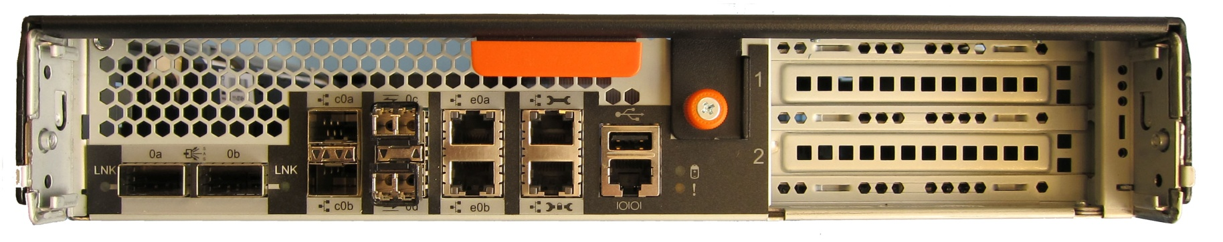
FAS/V3200 Controller I/O
HA
Serial
Console Port
USB
(disabled)
c0b c0a
Slot 1
Slot 2
e0a
e0b
ACP
Management (e0M / SP)
0a 0b
0c 0d
SAS
Ethernet
Fibre Chanel
e0a and e0b ports are GbE
Management and ACP ports are 10/100

Slide 5
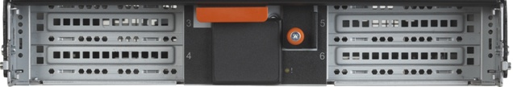
FAS/V3200 I/O Expansion Module (IOXM)
Slots with numbers
4 full-length PCIe v1.0 (Gen1) x8 slots

Slide 6
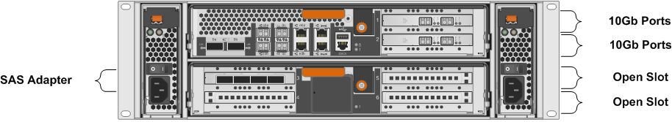
Controller Configuration Details

Slide 7
SAS Connectivity Details
Cable shelf to shelf IOMs from OUT ● to IN ■
A stack shelf IDs start with 00 and count up
B stack shelf IDs start with 10 and count up

Slide 8
ACP Connectivity Details
Cable shelf to shelf IOMs from OUT ● to IN ■

Slide 9
Network Connectivity Details
The SP is the wrench port on the FAS3250
The locked wrench port on the FAS3250 is used for ACP connectivity to the shelves
The e0a 1GbE port is used for management network connectivity
This should be a 1GbE connection, not 100Mb
The e1a and e2a ports are used for the private cluster network
The e1b and e2b 10GbE ports should be used to create a LACP ifgrp for data access
Additional NICs are required for connectivity to a different physical data network

Slide 10
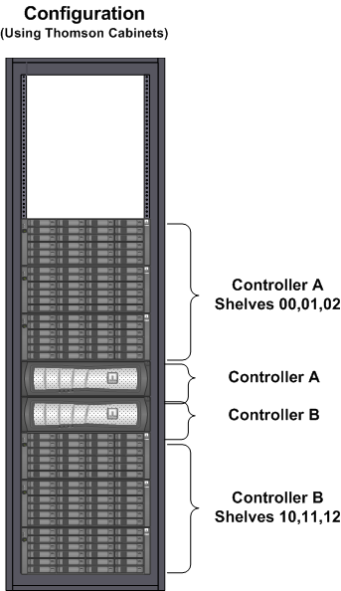
FAS3250 Log Backup – Cabinet Layout

Slide 11
Log Backup Aggregate Sizing
ONTAP VERSION | Clustered ONTAP 8.2P3 or higher
LIMITATIONS | Maximum aggregate size of 240TB Maximum volume size of 70TB
AGGREGATE CONFIGURATION | Dedicated 3 disk root aggregate on each node is required 1 data aggregate per node
RAID GROUP SIZE | 16 SATA drives per raid group in the data aggregate
INITIAL AND FINAL CONFIGURATION 6 DS4246 shelves | 1 root aggregate with 3 SAS drives per controller 1 data aggregate of 4 raid groups (64 drives) per controller 5 spare drives per controller 81TB usable per controller = 162TB total

